Slide 1

BEST PRACTICES FOR EFFECTIVE COMPUTER MANAGEMENT UGANDA NATIONAL HEALTH LABORATORY SERVICES(UNHLS)
PREPARED BY:
KASOLO RAJAB & KIBIRIGE JOSEPH MARTIN

Slide 2
QUICK LIST
Use passwords that can't be easily guessed, and protect your passwords.
Minimize storage of sensitive information.
Always make sure your work station is clean and free from dust
Make sure your computer is protected with anti-virus and all necessary security "patches" and updates.
Secure laptop computers and mobile devices at all times: Lock them up or carry them with you.
Shut down, lock, log off, or put your computer and other devices to sleep before leaving them unattended, and make sure they require a secure password to start up or wake-up.
Don't install or download unknown or unsolicited programs/apps.
Always keep liquid substances away from your working area.
Don’t place heavy substances on your workstations(system unit)

Slide 3
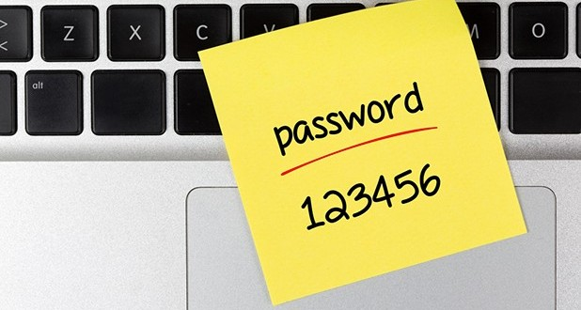
Use passwords that can't be easily guessed, and protect your passwords.
Don't share your passwords and avoid writing them down.
Characteristics of good, cryptic passwords:
Contain a mixture of upper and lower case letters, numbers, and symbols
At least 8 characters in length (or longer if they're less complex)
Difficult to guess (e.g. don't include real words or personal information like user name, names of family members, places, pets, birthdays, addresses, hobbies, etc.)

Slide 4

Minimize storage of sensitive information on your workstation.
Delete sensitive information whenever you can. Keep it off of your workstation, laptop computer, and other electronic devices if at all possible.
Don't keep sensitive information or your only copy of critical data, projects, files, etc. on portable or mobile devices (such as laptop computers, tablets, phones, memory sticks, CDs/DVDs, etc.) unless they are properly protected. These items are extra vulnerable to theft or loss.

Slide 5

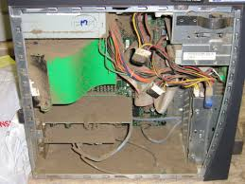
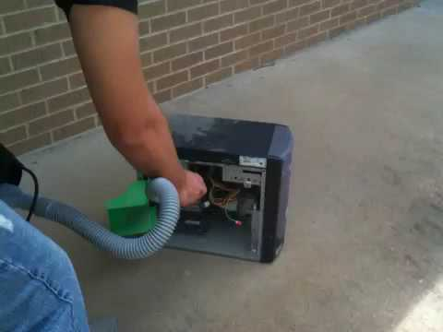
Always make sure your work station is clean and free from dust
A dusty computer will trap heat, which can reduce its performance and lifespan
Always do a simple clean up using a tissue or cotton towel to dust up your workstation.Incase you cannot do that please contact your IT person and make sure your workstation is clean and comfortable for use.

Slide 6
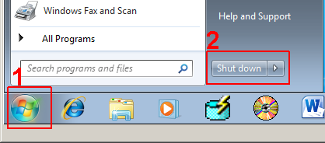
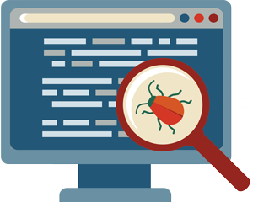
Make sure your computer is protected with anti-virus and all necessary security "patches" and updates.
Shut down or restart your computer at least weekly -- and whenever your programs tell you to in order to install updates. This helps to make sure software and security updates are properly installed.
If you get an antivirus alert that there is malware on your computer, contact the ITS Support for your Facility.

Slide 7
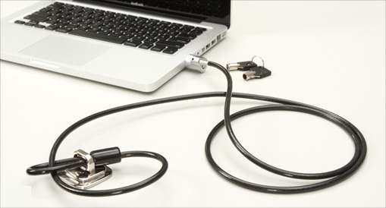
Secure laptop computers and mobile devices at all times: Lock them up or carry them with you.
In your office or laboratory at stores, meetings, conferences, etc. Remember: Phones and laptops get stolen from cars, houses, and offices all the time.
Make sure it is locked to permanent.

Slide 8
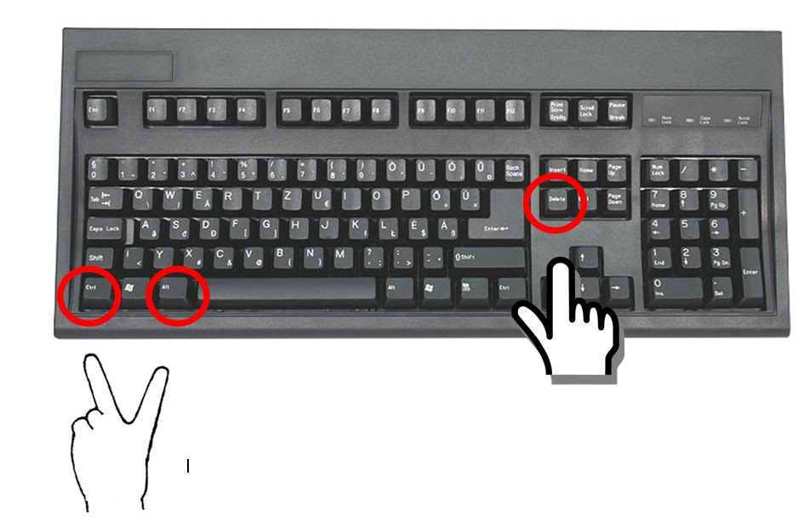
Shut down, lock, log off, or put your computer and other devices to sleep before leaving them unattended, and make sure they require a secure password to start up or wake-up.
<ctrl><alt><delete> or <Windows><L> on a PC; Apple menu or power button on a Mac
Also set your computer and portable devices to automatically lock when they're not being used.

Slide 9
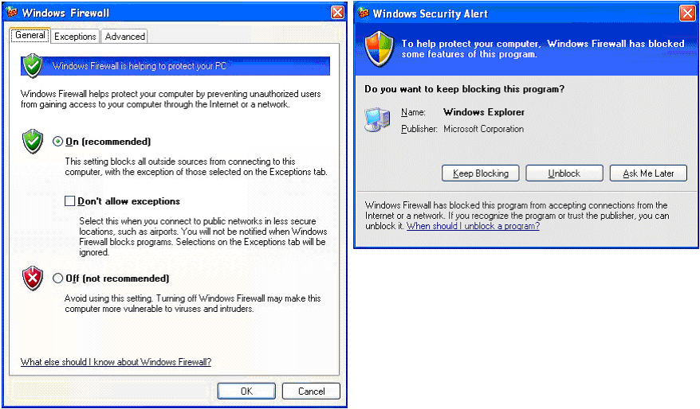
Don't install or download unknown or unsolicited programs/apps.
These can harbor behind-the-scenes viruses or open a "back door" giving others access to your devices without your knowledge.

Slide 10
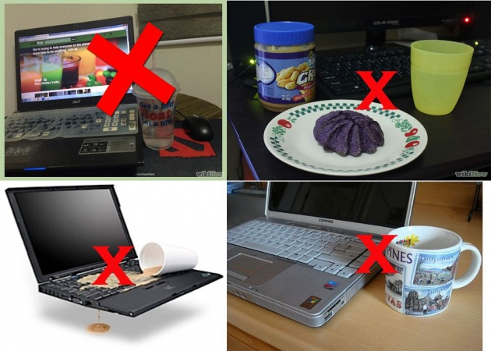
Always keep liquid substances away from your working area.
As tempting as it might be to drink coffee, soda, water or any other liquid near your desktop computer or laptop, accidents can happen all too easily. Spilled liquids may damage the internal microelectronic components or cause electrical damage.

Slide 11
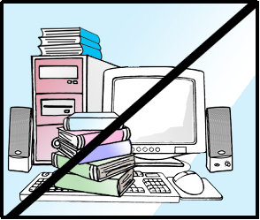
Don’t place heavy substances on your workstations(system unit)
These suffocate the system air circulation which might cause inefficiency of the entire computer system and also damage the keyboard.

Slide 12

Incase your workstation fails to start, Please always contact the IT person for any help.

